Slide 1
BELLS Update
8/15/2024

Slide 2
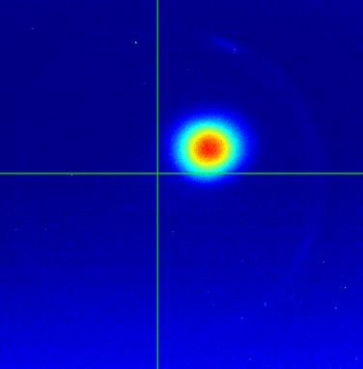
Photohybrid
Increased Charge
Reduced losses on UV transport
Well-defined operating phase

Slide 3
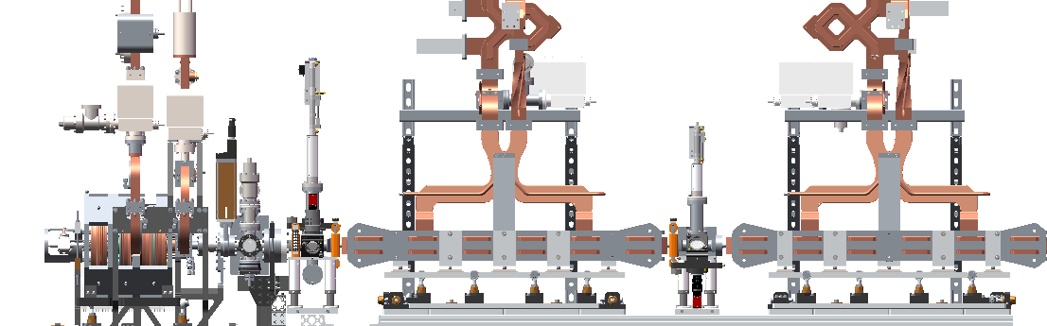
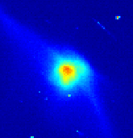
Linac Structures
Beam alignment and tuning
Similar settings day to day
Fast procedure (~30 min)
Structure tuning
Adjust phase/frequency to maximize energy
Coarse: deflection from steering magnet
Fine: dump dipole current
Steering 1
Steering 2
Steering 3

Slide 4
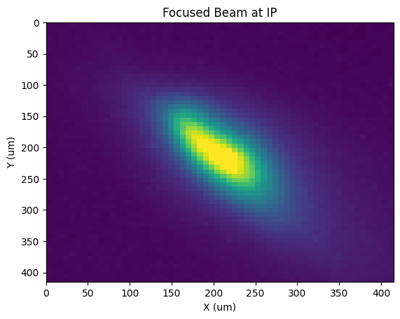

Beam Focusing
60 um spotsize at interaction point (IP)
7 um/pixel calibration
Tune with photohybrid correctors
Screen Alignment
Motorized IP screen
Alignment laser (long term benefits)

Slide 5
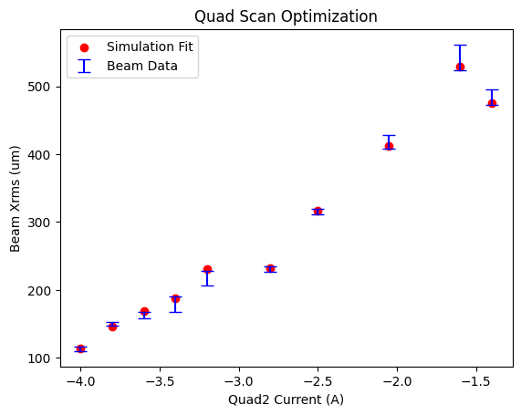
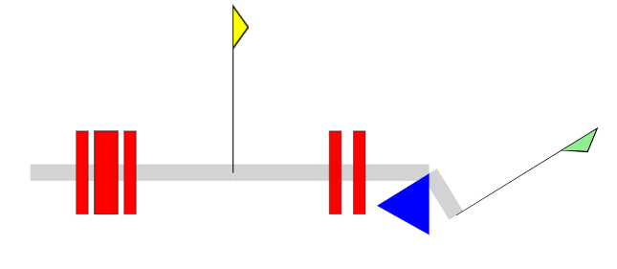
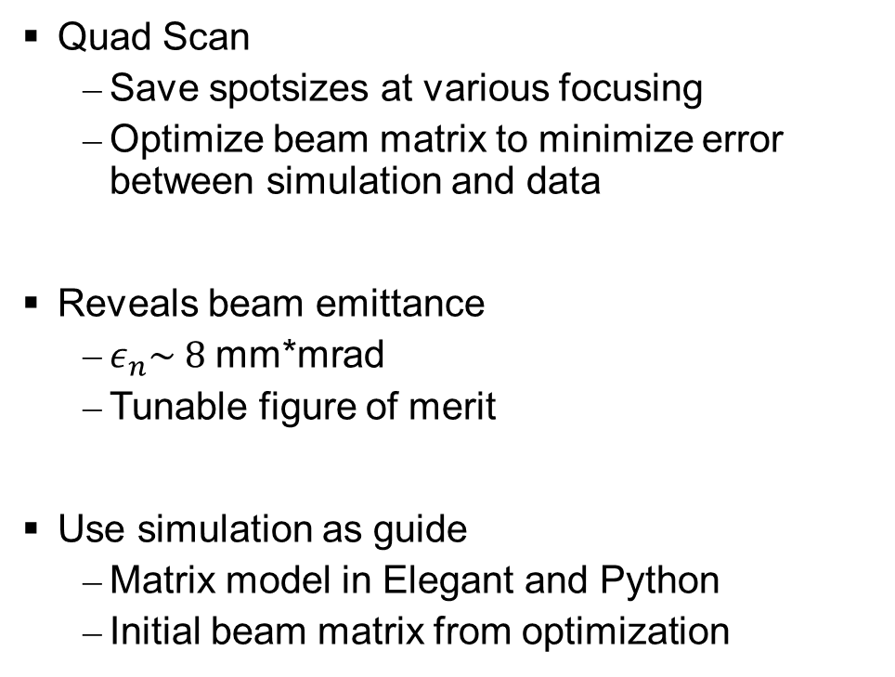
Quad Scan Measurement
Quad Scan
Save spotsizes at various focusing
Optimize beam matrix to minimize error between simulation and data
Reveals beam emittance
$ε_{n}\sim 8$ mm*mrad
Tunable figure of merit
Use simulation as guide
Matrix model in Elegant and Python
Initial beam matrix from optimization
Weak focusing
Strong focusing
Start
(Linac exit)
Triplet IP Doublet Dump

Slide 6
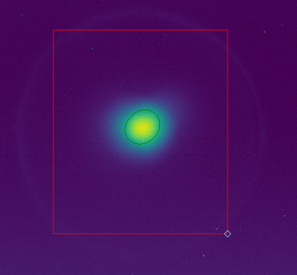
Data Collection
Saving images and beamline settings
Image statistics, charge, steering, quads, etc
Manual measurements
Utilize scripts to automate measurements
Quad scan, steering raster scans
Faster, repeatable
ROI
Gaussian Fit

Slide 7
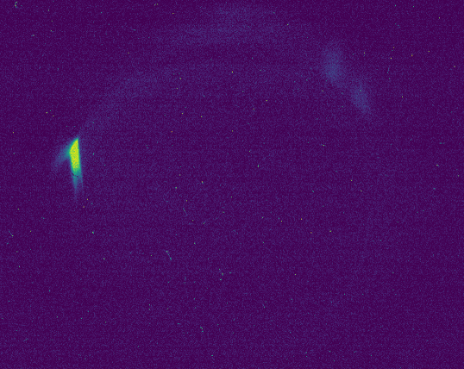
Beam Dump
Beam found at 146 Amps on dipole
Corresponds to ~90 MeV
Correctly manipulated by dipole and quads
Adding steering
Align after beamline upgrades
Fix dump to floor

Slide 8
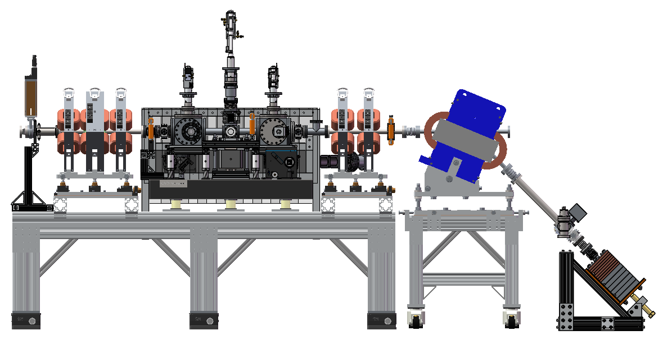
Current Beamline
Ion Pump on Tee
Replace Tee with Cross and add OTR, Move after Doublet
Stripline BPM
Replace with YAG or OTR
Button BPM
Replace with ICT
Button BPM
Replace with Stripline BPM

Slide 9
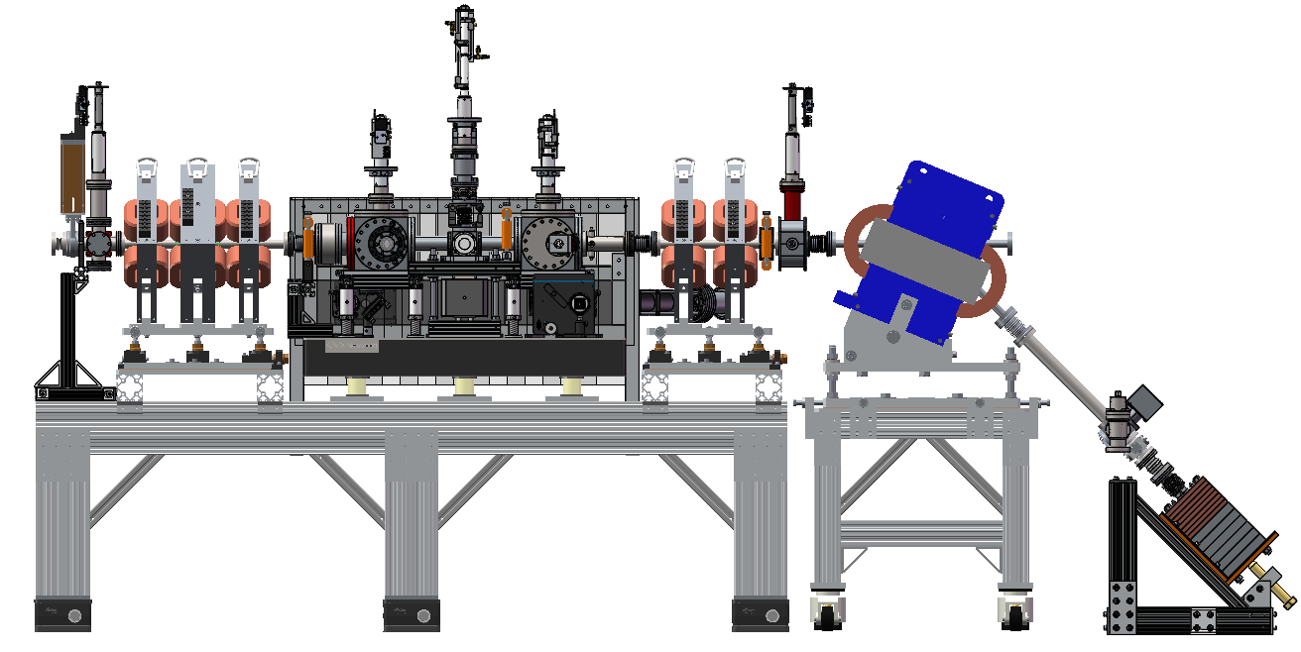
Proposed Solution
Stripline BPM
Remove Button BPM
Custom Length 6-way CF Cross
Modified G-11W-150 (in stock)
2.75” CF Cube
Ion Pump moved here
OTR Added
Install Comments:
Two steering magnets in hand
One pair of power supplies
Nathan ordered more
YAG after IP for pinhole alignment.
ICT
Add 4.5” to 2.75” ZLR & Custom Adapter to 6” Cube, Studs needed

Slide 10
Alignment Laser

Slide 11
IR Laser Status

Slide 12
RF Status

Slide 13
Next Steps
Install steering and diagnostics (ICT and screens)
Optimize structures with dump dipole
Transport electron beam through pinhole
Run for light

